Slide 1

Birla Vishwakarma Mahavidhyalaya
2CP09 : Programming lab
Topic: Maze Runner
Submitted By:
Submitted To:
Bhumit Bedse (19CP012)
Ujef Malek (19CP013)
Jimish Ravat (19CP015)
N. M. Patel

Slide 2
Roadmap
1
2
3
4
Overview
Algorithm
Pseudo
Code
Actual Implementation

Slide 3

Maze Runner
Maze runner is simple single player game
Here player have to find the path from the origin to the given destination in order to win the game

Slide 4
Algorithm
Main Menu
Play
Level 1
Level 2
Level 3
Winner
Help
Rules
Exit

Slide 5
Pseudo Code
-> Main menu
->if play
-> go to level 1 map
-> loop:
-> until reached to destination remain on this map and check conditions for the correct path
-> after level 1 go to level 2 map
-> loop:
-> until reached to destination remain on this map and check conditions for the correct path
-> after level 2 go to level 3 map
-> loop:
-> until reached to destination remain on this map and check conditions for the correct path
-> declare winner and exit program
->if help
-> open the rules windows
->if exit
-> exit the program

Slide 6
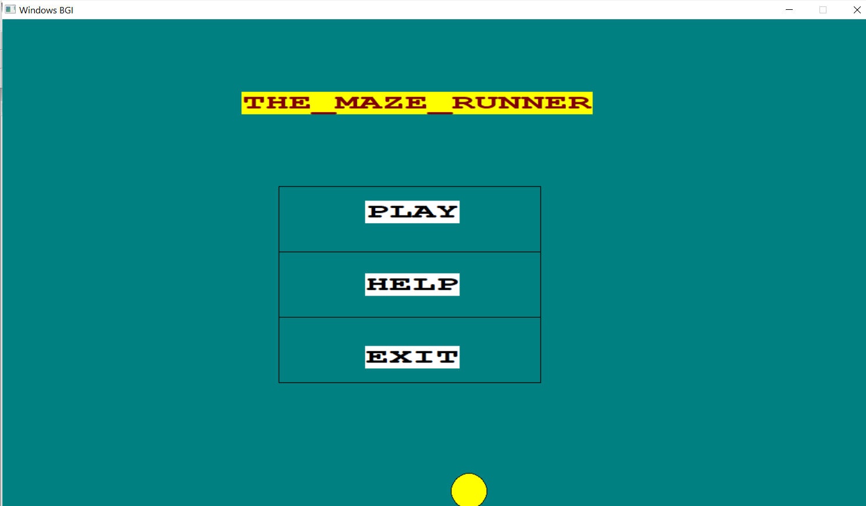

Slide 7
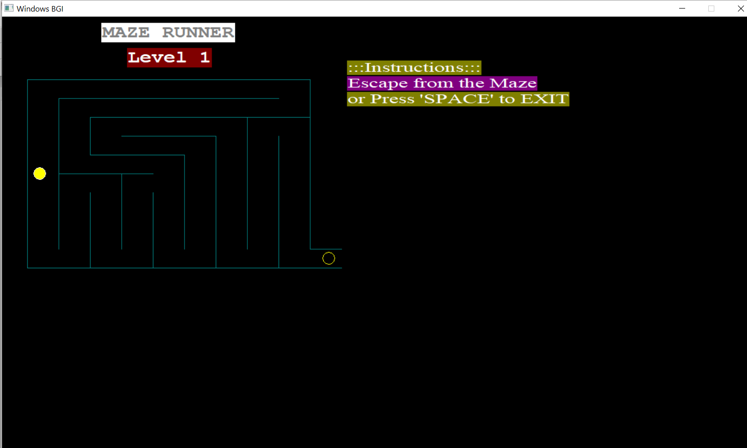

Slide 8
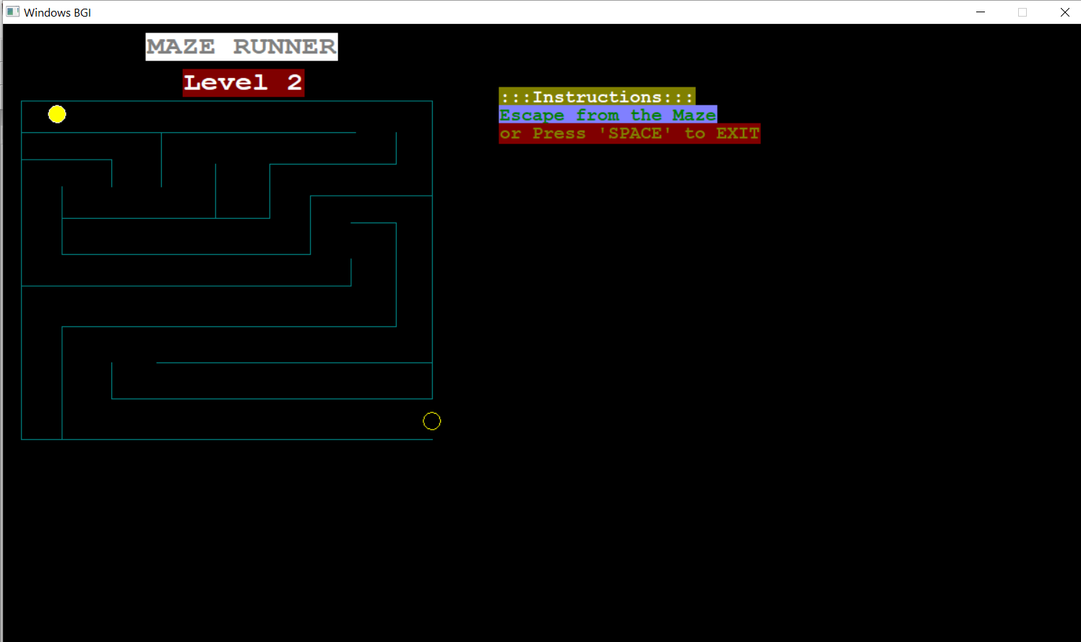

Slide 9
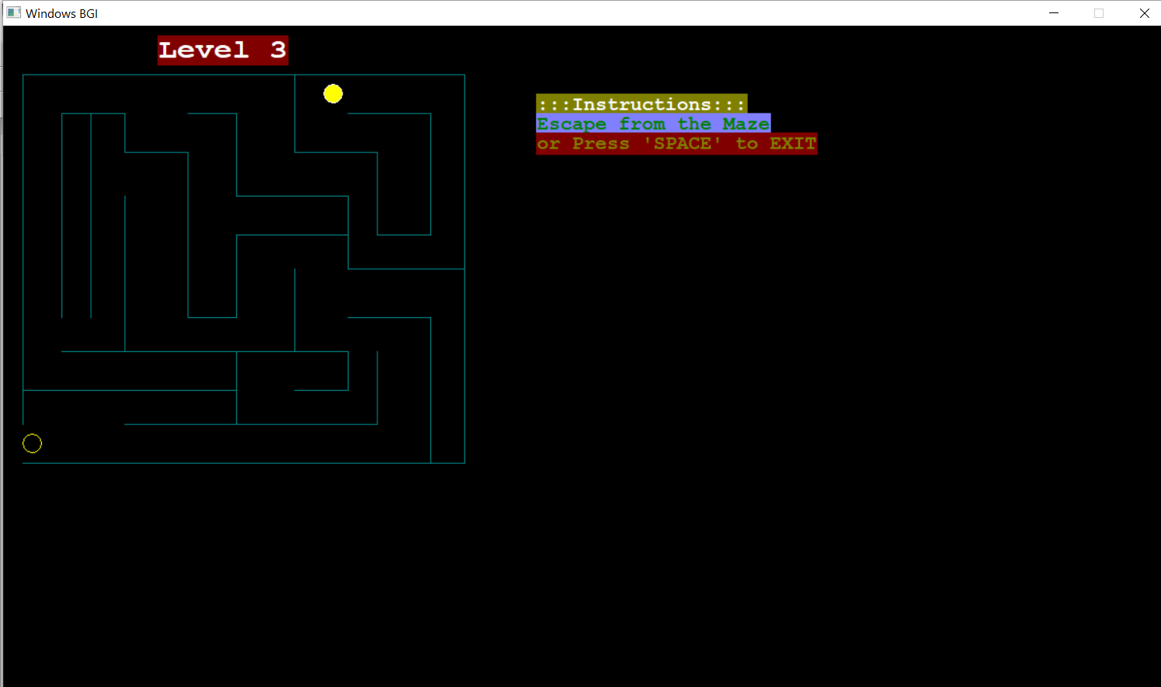

Slide 10
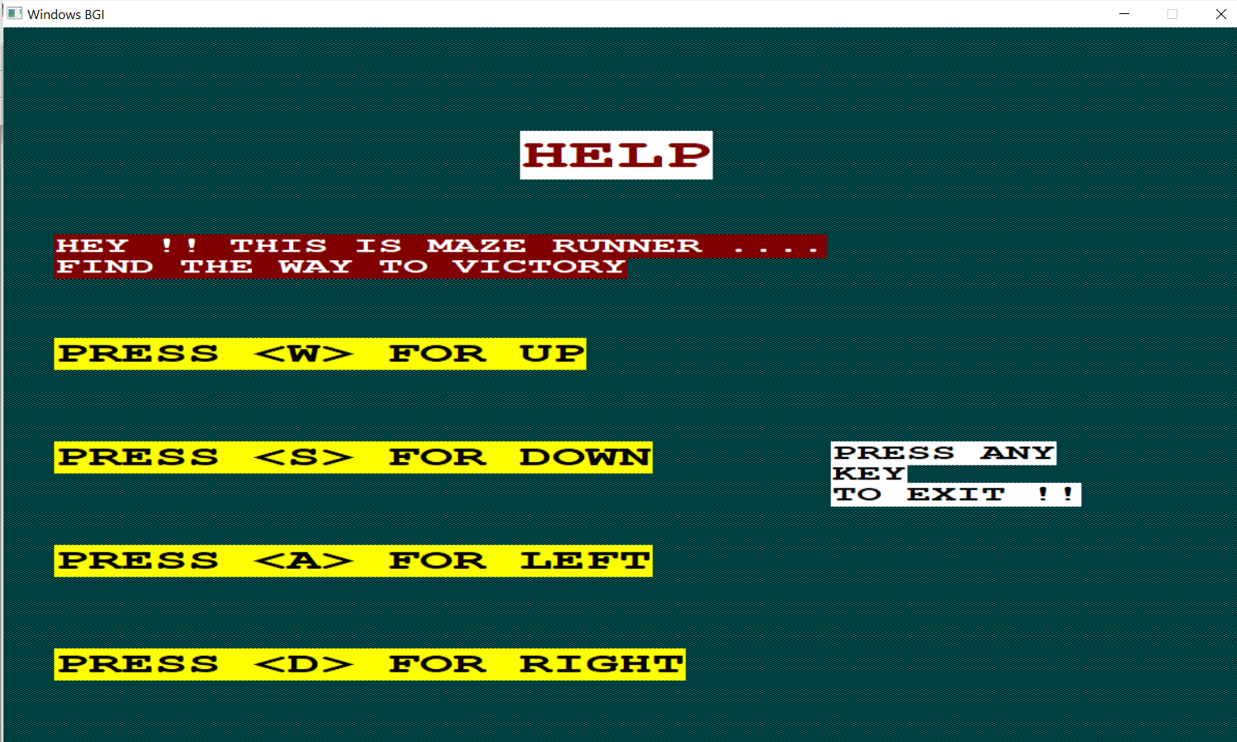

Slide 11
